Slide 1
(Un)Important CGPA IS?
ANALYSIS
Probability and stats
How
Presented to: Sir Faisal Bukhari

Slide 2
Presented By:
ANALYSIS
Probability and stats
BSDSF21A004 Abdul Moeed
BSDSF21A007 M. Soban Anjum
BSDSF21A024 Eman Munir Ch
BSDSF21A030 Kashuf Naeem
BSDSF21A038 Aymen Khan
BSDSF21A047 Iqra Haris

Slide 3
INTRODUCTION
ANALYSIS
Probability and stats
Academic performance depends on both our skills and CGPA considering how both are related to each other and one opens door for the other. There is a difference between what we should know and learn, the curriculum and syllabus have failed to realize it big time.
We are asking the respondents, what is their point of view in succeeding.

Slide 4
TABLE OF CONTENT
Information
CGPA
01
02
GpA vs skills
Jobs/experience
03
04
ANALYSIS
Probability and stats
General questions to generate where our data is from
Questions relating cgpa surrounding their university level
The comparison for gpa vs skills, what outshines the other
How experience and jobs are related to skills and cgpa

Slide 5
01
InfoRmation
ANALYSIS
Probability and stats
General
Gender, department and your university year

Slide 6
Gender Division:
ANALYSIS
Probability and stats
Female
59.9%
The number of female respondents
Male
40.1%
The number of female respondents

Slide 7
Category:
25.4%
20.7%
23.3%
30.6%
ANALYSIS
Probability and stats
Senior
Others
Junior
Freshman

Slide 8
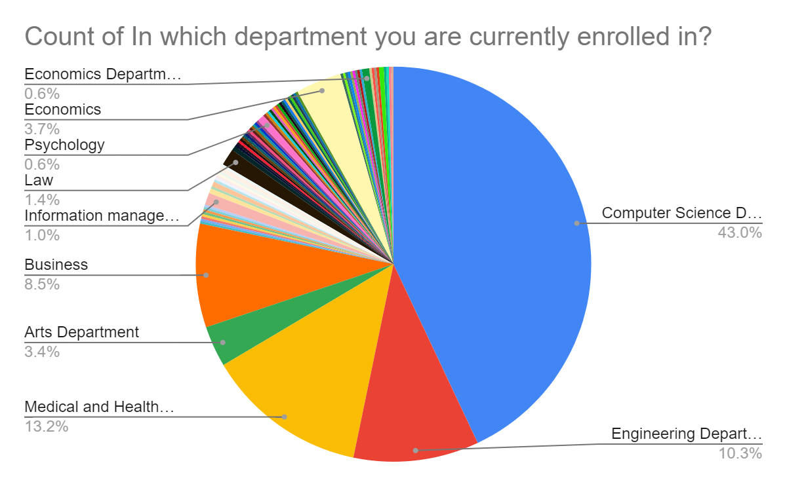
ANALYSIS
Probability and stats

Slide 9
02
( Cumulative Grade Point Average )
ANALYSIS
Probability and stats
CGPA
Current CGPA, indicator of ability and IQ level

Slide 10
ANALYSIS
Probability and stats

Slide 11
ANALYSIS
Probability and stats
What is your current CGPA?
Success: 3.1 – 3.5
Confidence Interval:
0.3702 < p < 0.4418
Testing:
Claim: CGPA of 40% of the population is between 3.1-3.5.
H₀ : p <= 0.40
H₁ : p > 0.40
Zcal = 5.208
Ztab = 1.64
So, the claim is wrong. We are 95% confident that less than 30% disagree that CGPA defines our IQ.

Slide 12
ANALYSIS
Probability and stats

Slide 13
ANALYSIS
Probability and stats
Do you think CGPA is a good indicator of ability?
Success: No
Confidence Interval:
0.3173< p<0.4007
Testing:
Claim: 40% of the population is aware that CGPA is a good indicator of ability.
H₀ : p >= 0.40
H₁ : p < 0.40
Zcal = -1.88
Ztab = 1.64
So, the claim is wrong. We are 95% confident that less than 30% disagree that CGPA defines our IQ.

Slide 14
ANALYSIS
Probability and stats
1 = Highly Disagree
5 = Highly Agree

Slide 15
MENU
ANALYSIS
CONTACT
Probability and stats
Does CGPA defines your IQ?
Success: disagree
Confidence Interval:
0.29 < p < 0.36
Testing:
Claim: More than 30% disagree that CGPA defines IQ!
H₀ : p <= 0.30
H₁ : p > 0.30
Zcal = 1.47
Ztab = 1.64
So, the claim is wrong. We are 95% confident that less than 30% disagree that CGPA defines our IQ.

Slide 16
03
SKILLS
ANALYSIS
Data ANALYSIS
GGPA
versus
Gender, department and your university year

Slide 17
ANALYSIS
Probability and stats

Slide 18
ANALYSIS
Probability and stats
Would you rather focus on your Skills or your CGPA?
Success: partially working on both.
Confidence Interval:
0.47 < p < 0.54
Testing:
Claim: More than 50% students are working on both!
H₀ : p <= 0.50
H₁ : p > 0.50
Zcal = 0.45
Ztab = 1.64
So, the claim is right. We are 95% confident that more than 50% of the students are working on both CGPA and Skills.

Slide 19
ANALYSIS
Probability and stats

Slide 20
ANALYSIS
Probability and stats
Is it possible to maintain a Good CGPA and Good Skills at the same time?
Success: agree
Confidence Interval:
0.27 < p < 0.34
Testing:
Claim: 60% of the population thinks that it is possible to maintain good CGPA and good skills at the same time!
H₀ : p >= 60
H₁ : p < 60
Zcal = -13.3
Ztab = 1.64
We will reject H₀ which means more than 60% of the population thins that it is possible to maintain good CGPA and good skills at the same time.

Slide 21
04
experience
ANALYSIS
Data ANALYSIS
Jobs
Gender, department and your university year

Slide 22
ANALYSIS
Probability and stats

Slide 23
ANALYSIS
Probability and stats
Does a prestigious university will get you a well-paid job?
Success: agree
Confidence Interval:
0.25 < p < 0.32
Testing:
Claim: 40% of the population thinks that it is possible to maintain good CGPA and good skills at the same time!
H₀ : p >= 0.40
H₁ : p < 0.40
Zcal = -5.05
Ztab = 1.64
We will not reject H₀ which means 40% of the population believes that a prestigious university will get you a well-paid job.

Slide 24
ANALYSIS
Probability and stats

Slide 25
ANALYSIS
Probability and stats
What is more crucial Resume/CV?
Success: both
Confidence Interval:
0.432 < p < 0.518
Testing:
Claim: Experience and CGPA both are crucial on CV for 50% of population!
H₀ : p >= 50%
H₁ : p < 50%
Zcal = -1.1258
Ztab = 1.64
Not 50% of population think that both, experience and CGPA are crucial on resume/CV.

Slide 26
ANALYSIS
Probability and stats

Slide 27
ANALYSIS
Probability and stats
What would you prefer?
Success: Career learning with low paying jobs
Confidence Interval:
0.467 < p < 0.380
Testing:
Claim: Less than 50% population prefer career learning skills with low paying jobs!
H₀ : p >= 0.50
H₁ : p < 0.50
Zcal = -3. 422
Ztab = -1.64
Not 50% of population prefer career learning with low- paying jobs

Slide 28
ANALYSIS
Probability and stats

Slide 29
ANALYSIS
Probability and stats
A person with a good CGPA but have no Skills related to his/her field. Will he/she get a good job in future?
Success: No
Confidence Interval:
0.7643 < p < 0.8806
Testing:
Claim: More than 80% of the people believes that the person having no Skills will not a good job in future!
H₀ : p <= 0.80
H₁ : p > 0.80
Zcal = 1,242
Ztab = 1.645
We will reject Ho because Zcal is greater than Ztab, which means more than 80% of the population believes that the person having no Skills will not a good job in future

Slide 30
ANALYSIS
Probability and stats

Slide 31
ANALYSIS
Probability and stats
Choose one of the following:
Success: CGPA isn’t meant to evaluate skill in the first place
Confidence Interval:
0.41151 < p < 0.48389
Testing:
Claim: More than 40% of the people believes that CGPA isn’t meant to evaluate skill in the first place!
H₀ : p <= 0.40
H₁ : p > 0.40
Zcal = 2.198
Ztab = 1.645
We will reject Ho which means more than 40% of the population believes that CGPA is a secondary indicator of Skill.

Slide 32
" It is not about that CGPA is the ultimate goal or CGPA doesn't matter at all. Find that sweet spot between your studies and extra curricular activities."
ANALYSIS
Probability and stats

